Slide 1

Exception Handling In Spark

Slide 2
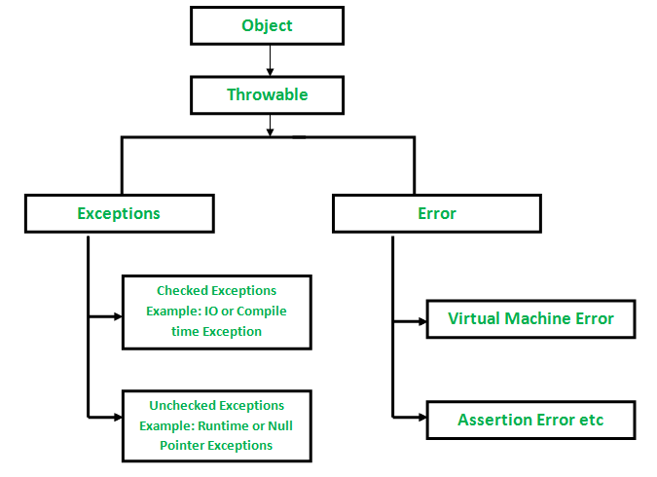
All exception and errors types are sub classes of class Throwable, which is base class of hierarchy. One branch is headed by Exception. This class is used for exceptional conditions that user programs should catch. NullPointerException is an example of such an exception. Another branch, Error are used by the Java run-time system(JVM) to indicate errors having to do with the run-time environment itself(JRE). StackOverflowError is an example of such an error.

Slide 3
How does Scala Exception Work?
Exceptions in Scala/Spark work the same way as in C++ or Java. When an exception occurs, say an ArithmeticException as shown in the previous example the current operation is aborted, and the runtime system looks for an exception handler that can accept an ArithmeticException. Control resumes with the innermost such handler. If no such handler exists, the program terminates.

